Slide 1
INTRODUCTION TO C LANGUAGE
PREPARED BY: NIDA WAHEED

Slide 2
INTRODUCTION TO C
The Unix operating system and virtually all Unix applications are written in the C language. C has now become a widely used professional language for various reasons.
Easy to learn
Structured language
It produces efficient programs.
It can handle low-level activities.
It can be compiled on a variety of computers.

Slide 3
INTRODUCTION TO C
C was used for systems programming. A system program is associated with the operating system of the computer or its support utilities. Operating Systems, Interpreters, Editors, Assembly programs are usually called systems programs.
C is thought of as a middle-level language because it combines elements of high-level languages and functionalities of an assembly (low-level) language.
C is structured language.

Slide 4
Program Structure
Some rules for programs written in C are as follows:
All keywords are lower cased
C is case sensitive, do while is different from DO WHILE
C FUNCTION:
C programs are divided into units called functions. The sample_code has only one function main(). The operating system always passes control to main() when a C program is executed.
The function name is always followed by parentheses. The parentheses may or may not contain parameters.

Slide 5
DELIMETERS
()
{}
STATEMENT TERMINATOR:
;
COMMENT LINES:
//

Slide 6
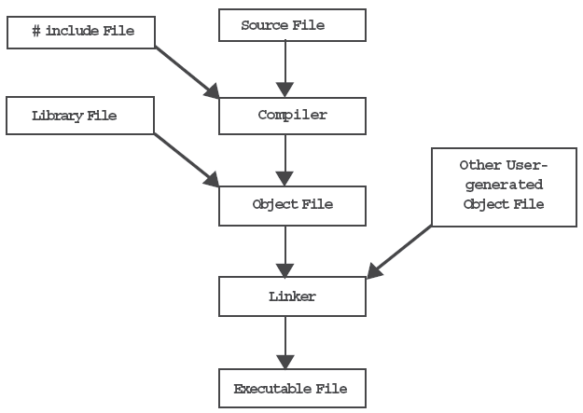
Compiling & Running a Program

Slide 7
WHY TO USE C?
C was initially used for system development work, in particular the programs that make-up the operating system. C was adoped as a system development language because it produces code that runs nearly as fast as code written in assembly language. Some examples of the use of C might be:
Operating Systems
Language Compilers
Assemblers
Text Editors
Print Spoolers
Network Drivers
Modern Programs
Data Bases
Language Interpreters
Utilities

Slide 8
C PROGRAM STRUCTURE
A C program basically has the following form:
Preprocessor Commands
Functions
Variables
Statements & Expressions
Comments

Slide 9
C COMPILERS
When you write any program in C language then to run that program you need to compile that program using a C Compiler which converts your program into a language understandable by a computer. This is called machine language (ie. binary format).

Slide 10
Pseudo code
Pseudo code uses a certain standard set of words, which makes it resemble a code. However, unlike code, pseudo code cannot be compiled or run.
Example 1:
BEGIN
‘ hello world’
END
EXAMPLE 2:
BEGIN
Input A,B
Display A+B
END

Slide 11
ALGORITHMS
A process or set of rules to be followed in calculations or other problem-solving operations, especially by a computer.
A sequential solution of any program that written in human language, called algorithm.
Algorithm is first step of the solution process, after the analysis of problem, programmer write the algorithm of that problem.

Slide 12
EXAMPLE OF ALGORITHM
Write a algorithm to find out number is odd or even?
step 1 : start
step 2 : input number
step 3 : rem=number mod 2
step 4 : if rem=0 then
print "number even"
else
print "number odd"
endif
step 5 : stop

Slide 13
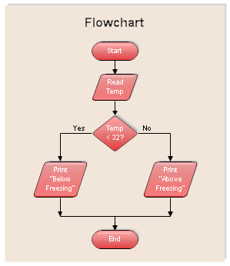
EXAMPLE OF FLOW CHART

Slide 14
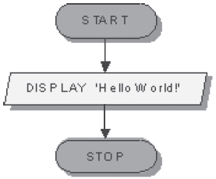
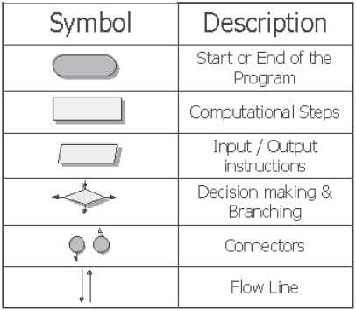
Flowcharts
A flowchart is a graphical representation of an algorithm. It charts the flow of instructions or activities in a process. Each such activity is shown using symbols.

Slide 15
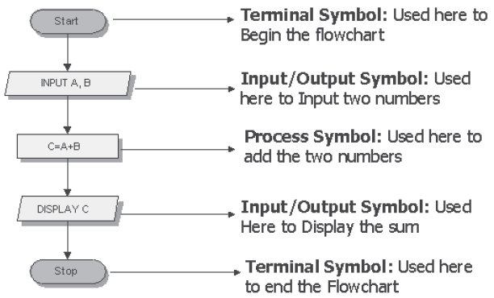
Flowcharts

Slide 16
IF CONDITION PSEUDO CODE
IF condition
Statements → Body of the IF construct
END IF
EXAMPLE 2:
BEGIN
INPUT num
r = num MOD 2
IF r=0
Display “Number is even”
END IF
END

Slide 17
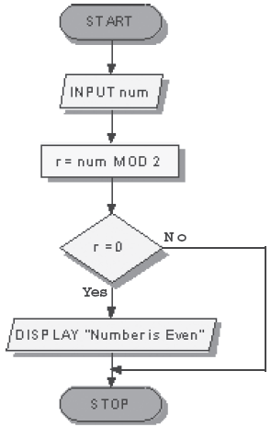
FLOW CHART
IF FLOW CHART

Slide 18
IF ELSE
if(condition)
{
statement set1
}
else
{
statement set2
}

Slide 19
PSEUDO CODE
EXAMPLE 1:
IF condition
Statement set1
ELSE
Statement set2
END IF
EXAMPLE 2:
BEGIN
INPUT num
r=num MOD 2
IF r=0
DISPLAY “Even Number”
ELSE
DISPLAY “Odd Number”
END IF
END

Slide 20
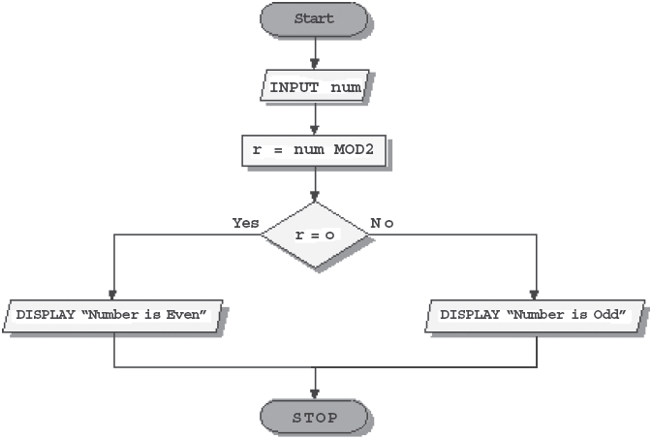
FLOW CHART
IF-ELSE

